Slide 1



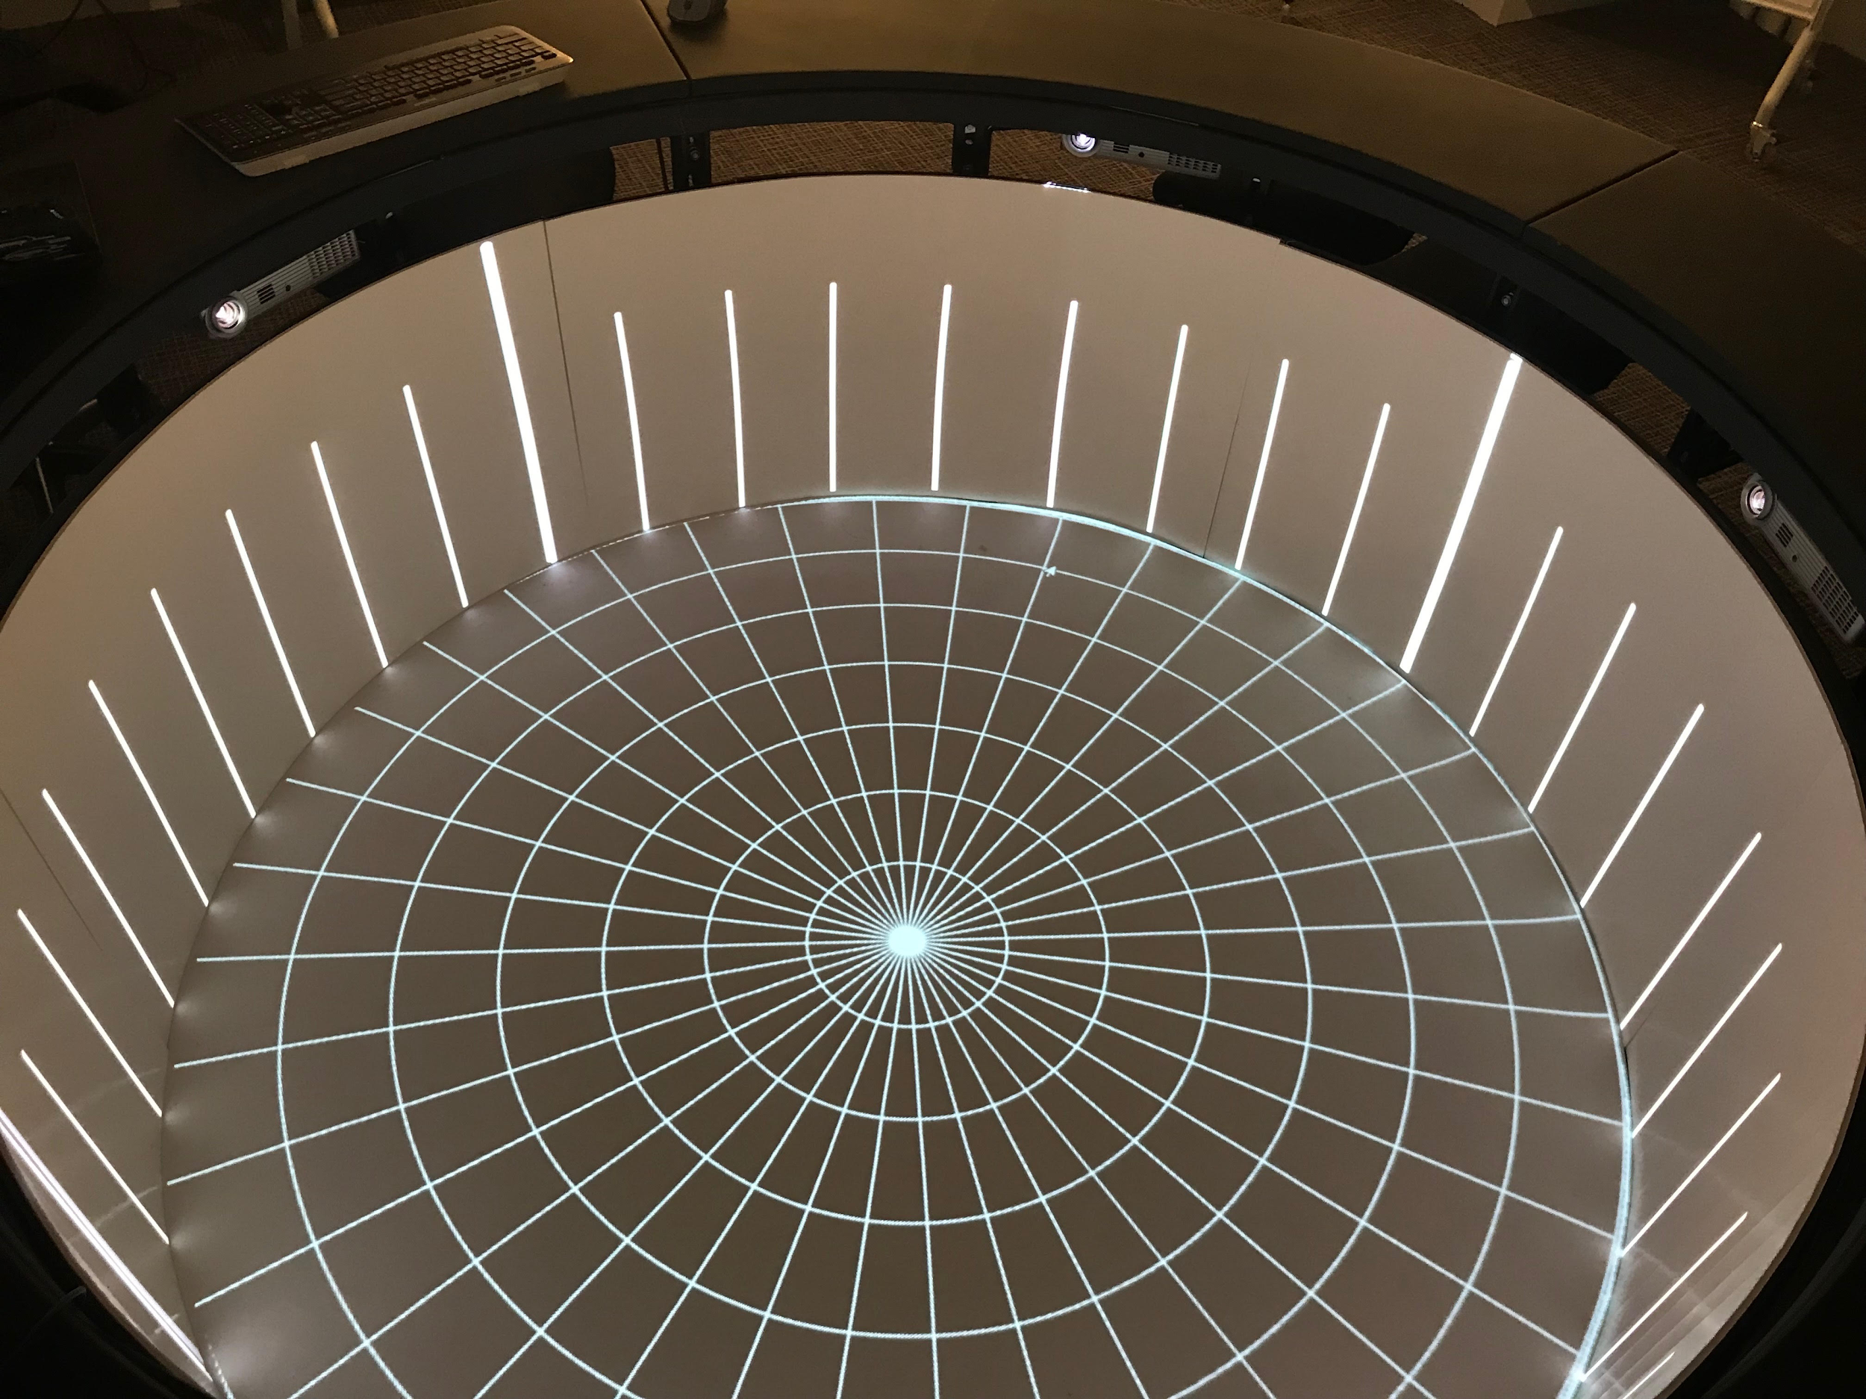



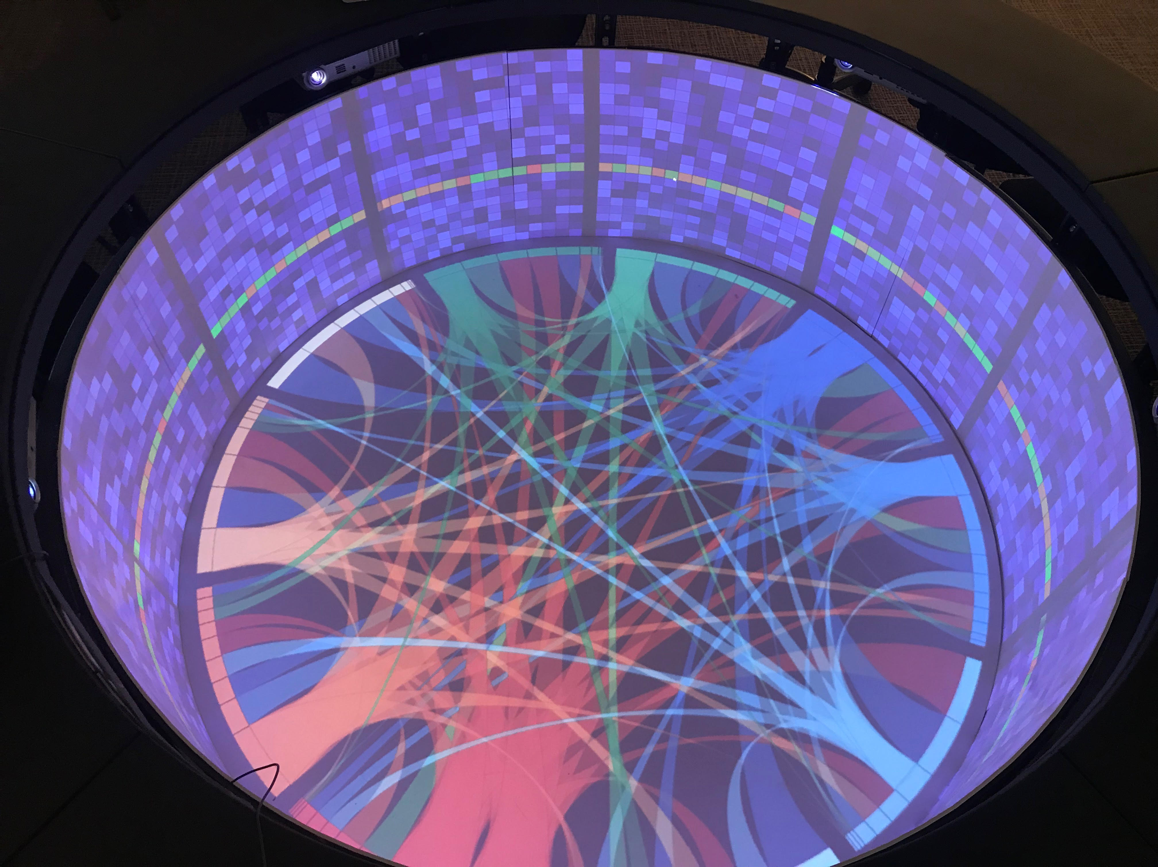
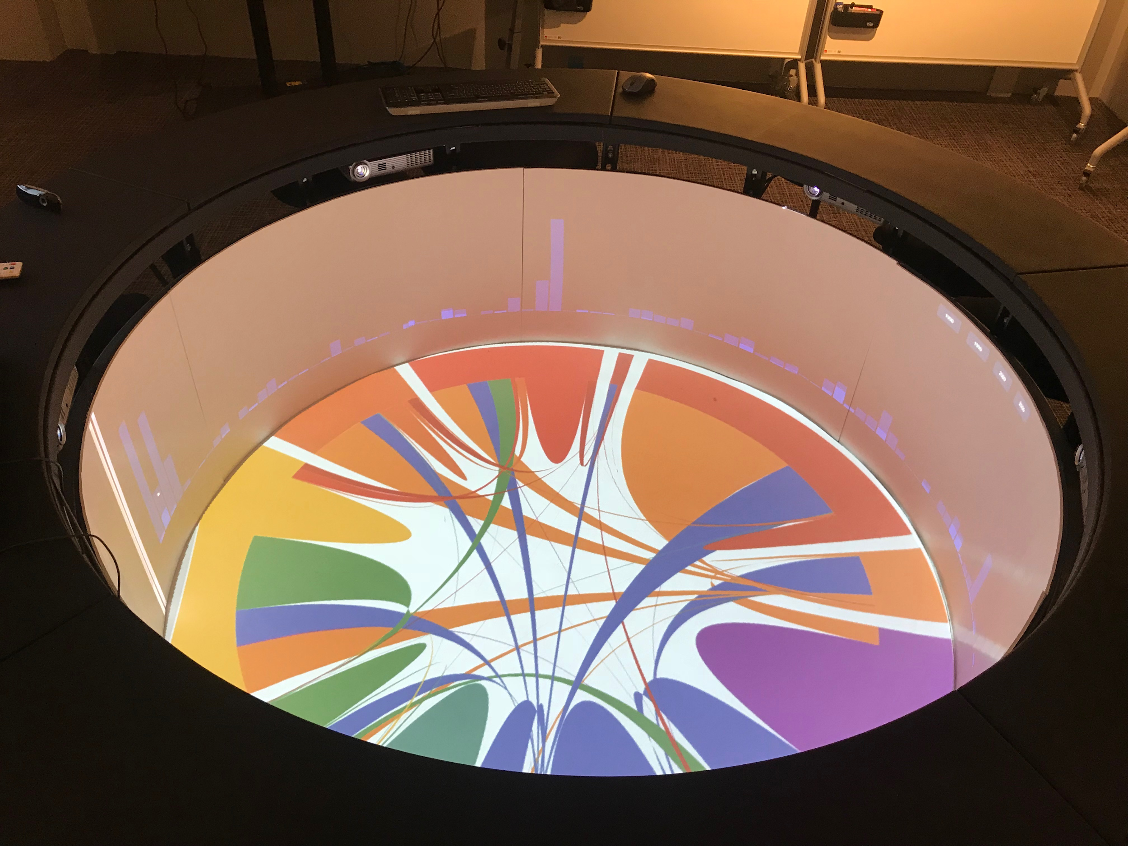


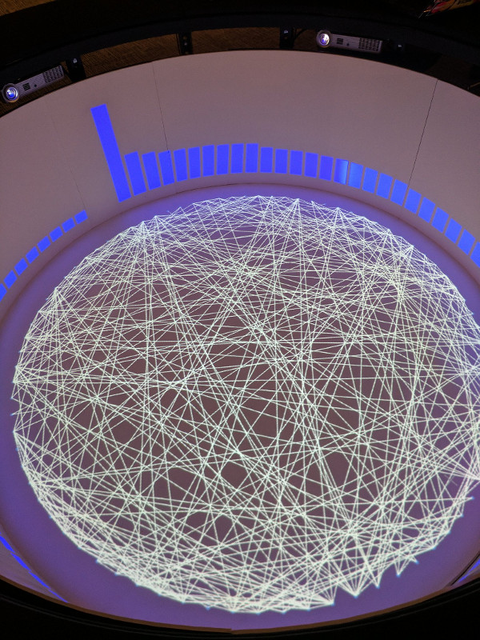
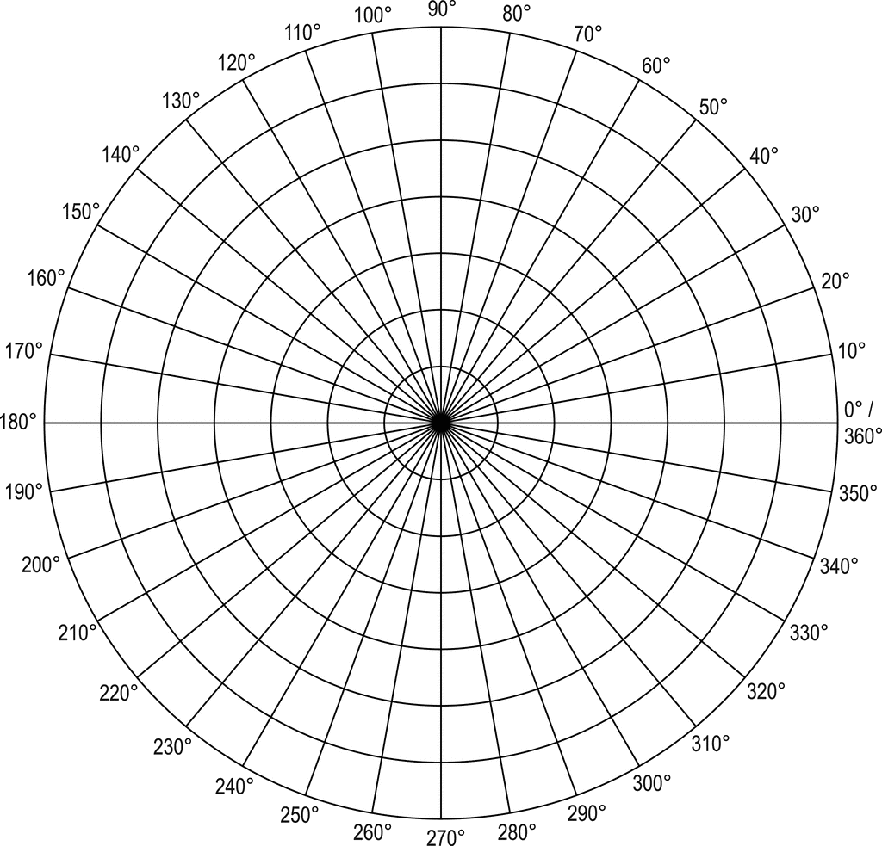
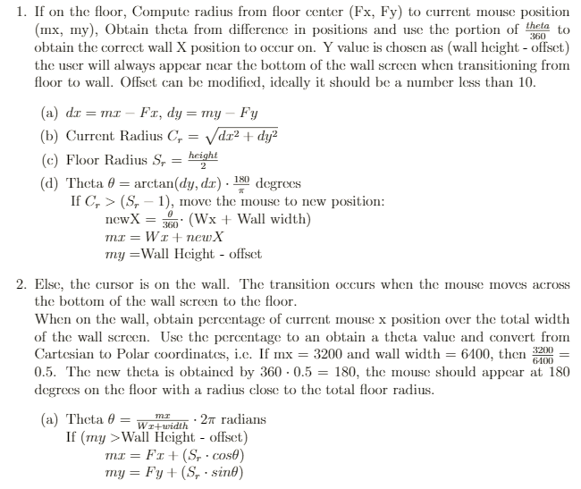

IDEA Campfire Mouse Wrangler Toolkit
Tommy Fang, Computer Science, Class of 2018, fangt@rpi.edu
Advisors: Prof. James Hendler, Prof. John Erickson
Rensselaer Polytechnic Institute, Troy, NY
Introduction
Mouse Wrangler Architecture
Background: The Campfire is a unique collaborative, immersive computing interface that utilizes a circular spatial component in order to present the relationships in large datasets and focus the attention of multiple users. Typical users have rectangular monitors for a TV or computer, but the panoramic screen and floor projection provides a new aspect of continuity, opening up a vast field of research in Human-Computer Interaction.
Problem: The Campfire requires further development to utilize the full potential of the hardware. For example, there are no drivers to assist in handling the transition from Cartesian to Polar coordinates which is necessary when using a mouse. The change in coordinate systems provides difficulty in navigating the interface because directions and borders of screens are lost in translation.
Solution: Develop an extensible toolkit, initially with a focus on handling the screen transitions of all apps of the Campfire device in order to ease the quality of life for Campfire developers and users. This is done using an Electron.js app which binds an event listener to mouse move. User movement can be detected upon input and processed by the mouse wrangler, which places the cursor at more natural positions. The wrangler will assist the user in transitioning to the correct screen based on input. (i.e. if the user moves from the border of the panoramic wall screen to the center floor screen, the mouse will seamlessly transition across.)
Core Technologies
HTML/CSS, JavaScript
The Mouse Wrangler can be run independently as an Electron application, with Node.js as the backend, and will take control of screen transitions for the user during any Campfire session.
The toolkit has been packaged as a module within the npm library.
A JavaScript file with the correct import of the library will easily enable the mouse utility features, which can be modified based on input parameters.
The mouse utility instantiates two event listeners utilizing win-mouse to hook onto the mouse drivers at the OS level.
Robotjs moves the cursor of the user for the user based on the user’s conditions.
Electron.js - framework for creating native desktop applications with web technologies utilizing Node.js for the backend and Chromium for the frontend developed by GitHub.
Mouse Wrangler
Robotjs, win-mouse,
Node.js, Electron
Node.js - Open-source Javascript run-time environment which unifies HTML/CSS and JavaScript into a single programming language.
Robotjs - JavaScript framework for automating user inputs.
User Input
Campfire
win-mouse - JavaScript module for binding an event listener to user mouse inputs.
npm - package manager for JavaScript, stores many JavaScript projects and allows easy installation of requirements.
Other
Applications
/Campfire Demos
Mouse Event Listener Logic
Wx, Wy
Top of Wall
Mouse Wrangler Specifications
F1
A2
A1
C1
C2
B1
B2
User at 12 O'Clock*
Leftward movement across Wall left edge (A1 -> A2) causes cursor to appear at Wall right edge (B1)
Rightward movement across Wall right edge (B1 -> B2) causes cursor to appear at Wall left edge (A1)
Left/Right movement within Wall (C1 <-> C2) causes cursor to move Left/Right within Wall
Up/Down movement within Wall (F1 <-> F2) causes cursor to move Up/Down within Wall
Downward movement across Wall bottom edge (D1 -> D2) causes cursor to appear at Floor edge (E1) according to Wall/Floor radial mapping (R)
Movement across Floor edge (E1 -> E2) causes cursor to appear at Wall bottom edge (D1) according to Wall/Floor radial mapping (R)
Left/Right movement within Floor (G1 <-> G2) causes cursor to move Left/Right within Floor
Up/Down movement within Floor (H1 <-> H2) causes cursor to move Up/Down within Floor
E2
D1
F2
D2
Wall, width Wall height
A1
D1
F1
Transitions
A2
B2
R
E2
C1
Fx⁰, Fy⁰: Floor origin
(typically -1920, 0)
Wx, Wy: Wall origin (typically 0,0) Fx, Fy: Floor center
(e.g. -960, 540)
Theta Range = (0, 360)
(0, 2ℼ)
mx, my: Mouse position
B1
C2
mx,my
D2
F2
E1
currentRadius
E1
H1
screenRadius
H2
G1
Θ
Fx,Fy
G2
H1
H2
R
12 O'Clock*
Fx⁰, Fy⁰ = -1920, 0
Wx, Wy = 0, 0
12 O'Clock is opposite entry door to Campfire Room
Upper-left corner of "Wall" screen
Shown "upside-down" to conform to "wrapping" of wall
Campfire screen orientation (reference)
Wall width, height = 6400, 800

